Slide 1
.Net TraiNING Week 1

Slide 2
AGENDA
Advance Data Types
- Dates
- Array/List
- Enums
- Using Strings
Control Structures
- If – Else
- Switch Case
- Ternary Operator
- For Loop and For Each Loop
- While Loop

Slide 3
Dates (DateTime, TimeOnly, DateOnly):
DateTime: Represents a date and time, including both date and time information. It's a versatile data type for working with timestamps and managing time-sensitive data.
Ex : DateTime mydate= DateTime.Now; // Output : 2023-11-03 14:30:00
TimeOnly: It represents a time of day without a date component. Useful for scenarios where you only need to work with time information.
Ex : TimeOnly time = new TimeOnly(14, 30); // Output : Time: 14:30:00
DateOnly: It represents a date without a time component. Useful when you need to work with dates but don't need to consider specific times.
Ex : DateOnly myDateOnly = new DateOnly(2023, 1, 1); // O/p : 1/01/2023

Slide 4
Dates Functions
Adding/Manipulating Dates and Times:
AddDays, AddHours, AddMinutes, AddMonths, AddSeconds, AddYears: These methods allow you to add or subtract specific time intervals to a DateTime object.
Formatting and Parsing:
ToString(format): Formats the DateTime as a string according to the provided format.
Properties:
Year, Month, Day, Hour, Minute, Second

Slide 5
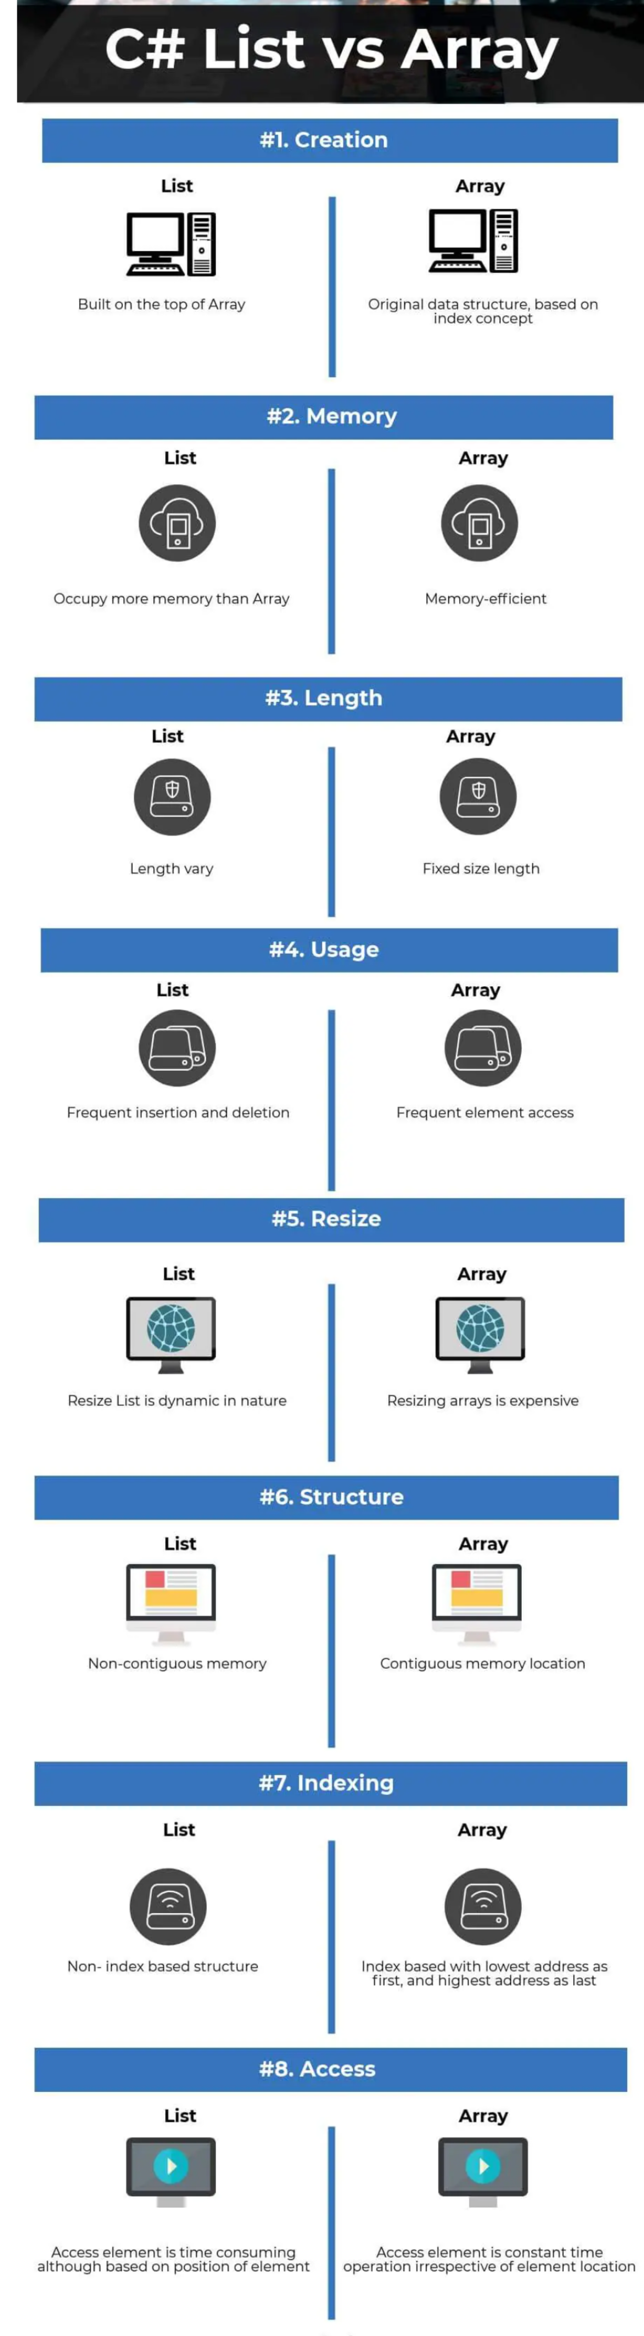
Array / List
Array: A fixed-size collection of elements of the same data type. Arrays are indexed from 0 to N-1 and have a predefined length. You need to specify the size when creating an array, and it cannot be changed.
List: Part of the System.Collections.Generic namespace, it's a dynamic collection that can grow or shrink in size as needed. Lists are more flexible than arrays and provide various methods for adding, removing, and manipulating elements.

Slide 6
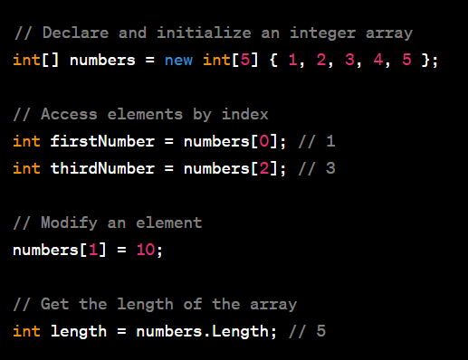
Array Example and Functions

Slide 7
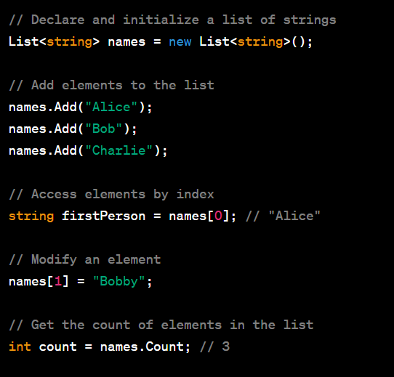
List Example and Functions

Slide 8
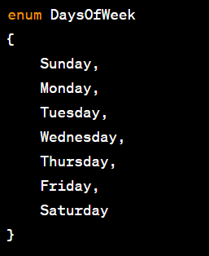
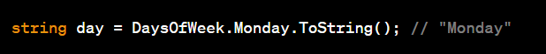
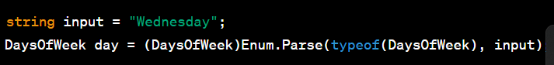
Enum
Enums:
Enums, short for enumerations, allow you to define named integral constants. They provide a way to create symbolic names for values that are easy to understand and use in code. Enums make the code more readable and self-explanatory, particularly in situations where you have a fixed set of related values.

Slide 9
Strings
String is a data type used to represent text as a sequence of characters
They are widely used for storing and manipulating textual data.
Declaring a String
string myString = "Hello, World!";
String Concatenation: You can concatenate strings using the + operator or by using the string.Concat method.
string firstName = "John"; string lastName = "Doe"; string fullName = firstName + " " + lastName;
String Interpolation: C# provides string interpolation to embed expressions within strings using the $ character.
string firstName = "John";
int age = 30; string message = $"My name is {firstName} and I am {age} years old";

Slide 10
String Functions
1. String.Length: gets the length (number of characters) of a string.
2. String.Concat(): combines multiple strings into a single string.
3. String.Equals(): compares two strings for equality. It has overloads that allow you to specify comparison options (e.G., Case-insensitive).
4. String.Indexof(): returns the index of the first occurrence of a specified character or substring within the string.
5. String.Lastindexof(): returns the index of the last occurrence of a specified character or substring within the string.
6. String.Contains(): checks if a string contains a specified substring.
7. String.Startswith(): checks if a string starts with a specified prefix.
8. String.Endswith(): checks if a string ends with a specified suffix.
9. String.Substring(): extracts a substring from a string, starting at a specified index.
10. String.Split(): splits a string into an array of substrings based on a specified separator.
12. String.Toupper(): converts a string to uppercase.
13. String.Tolower(): converts a string to lowercase.
14. String.Replace(): replaces all occurrences of a specified substring with another string.

Slide 11
.Net TraiNING Week 2

Slide 12
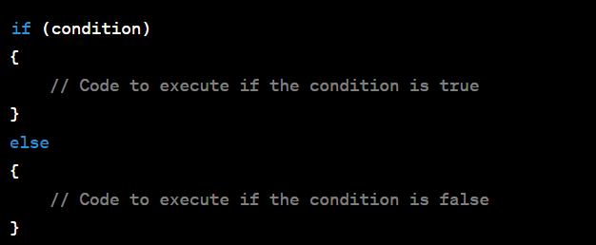
Control Structures
if-else statement is used for conditional branching. It allows you to execute different blocks of code based on a condition. Here's the basic syntax:

Slide 13
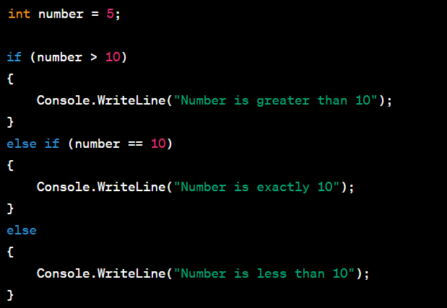
Sample Code

Slide 14
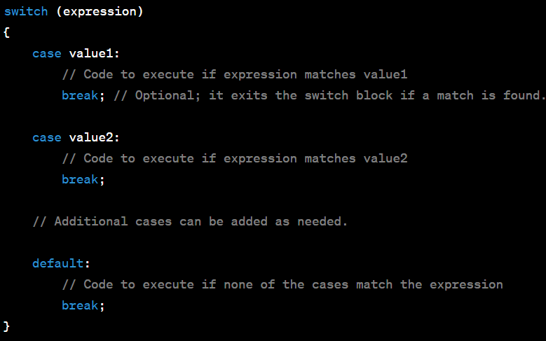
Switch CAse
switch statement is used for selective, multi-way branching. It provides a way to execute different code blocks based on the value of an expression. Here's the basic syntax of a switch statement:

Slide 15
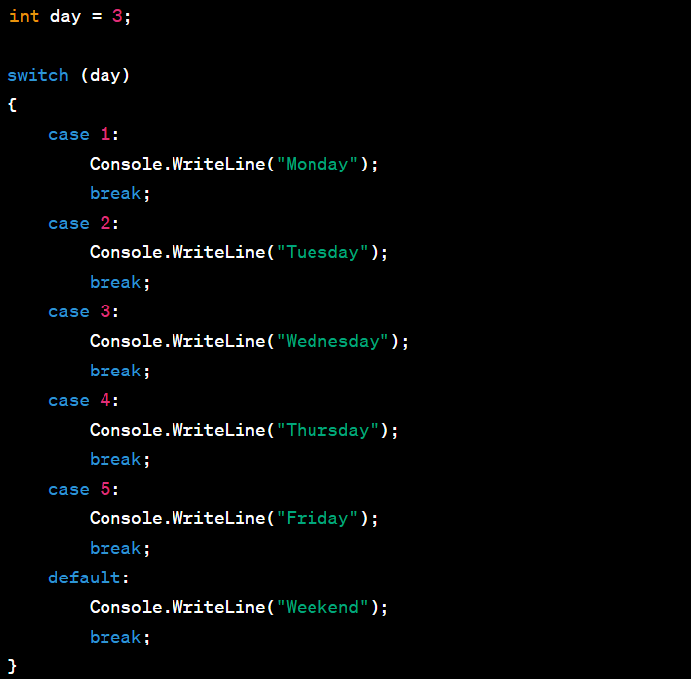
Sample Code

Slide 16
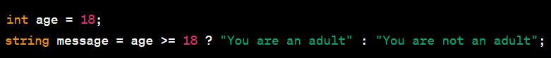
Ternary OPerator
The ternary operator in C# is a shorthand way to write an if-else statement with a single expression. It allows you to conditionally choose between two values or expressions based on a Boolean condition. The syntax of the ternary operator is as follows:
Example :

Slide 17
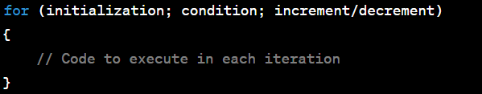
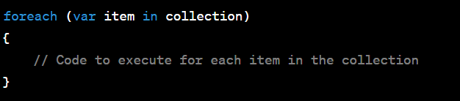
For Loop and For Each Loop
for Loop:
A for loop is typically used when you need to iterate a specific number of times or when you want to have more control over the loop. The for loop has the following syntax:
foreach Loop:
A foreach loop is used when you want to iterate through the elements of a collection, such as an array, list, or other IEnumerable object. The foreach loop abstracts away the index and provides a simple way to access each element. The syntax is as follows:
string[] cars = {"Volvo", "BMW", "Ford", "Mazda"}; foreach (string i in cars) { Console.WriteLine(i); }

Slide 18
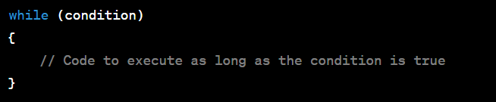
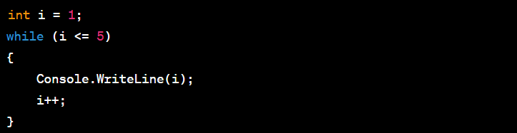
While Loop
While Loop:
while loop is a control flow structure that allows you to repeatedly execute a block of code as long as a specified condition remains true. The syntax of a while loop is as follows:
ex :

Slide 19
Assignment - Project
mini-project that involves CRUD (Create, Read, Update, Delete) operations using a list, for and foreach loops, if-else statements, and a switch case in C#. In this project, we'll create a basic task list application.
Project Description: Simple Task List Application
Features:
Create a task: Add a new task with a title
Read tasks: Display the list of tasks with their titles and descriptions.
Update a task: Modify the title or description of an existing task.
Delete a task: Remove a task from the list.
Exit: Exit the application.

Slide 20
Thank You

